Slide 1

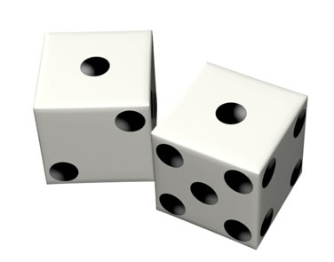
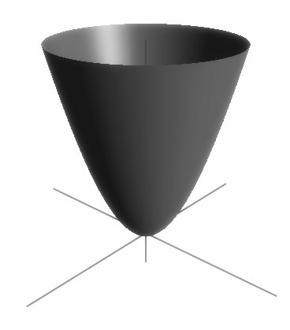
Pseudorandom Generators for Polynomial Threshold Functions
Raghu Meka
UT Austin
(joint work with David Zuckerman)

Slide 2
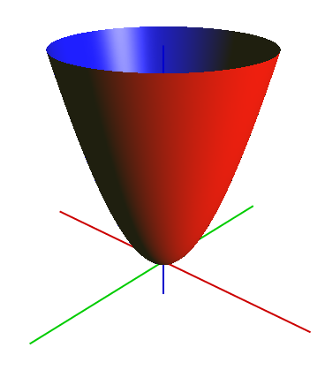
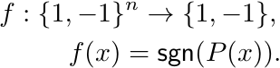
Polynomial Threshold Functions
Applications: Complexity theory, learning theory, voting theory, quantum computing

Slide 3
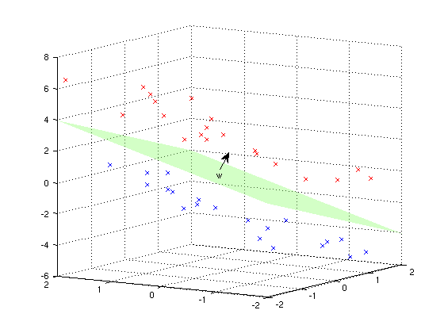
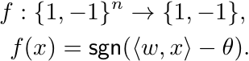
Halfspaces
Applications: Perceptrons, Boosting, Support Vector Machines

Slide 4
Good PRGs for PTFs?
This Work
First nontrivial answer for degrees > 1.
Significant improvements for degree 1.
Generic techniques: PRGs from CLTs, monotone trick.
Important in Complexity theory.
Algorithmic applications: explicit Johnson-Lindenstrauss families, derandomizing Goemans-Williamson.

Slide 5
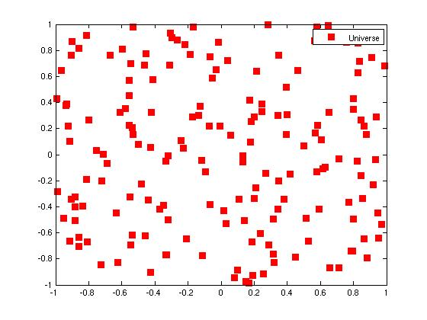
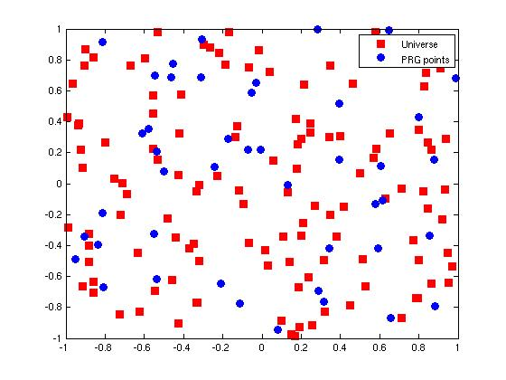
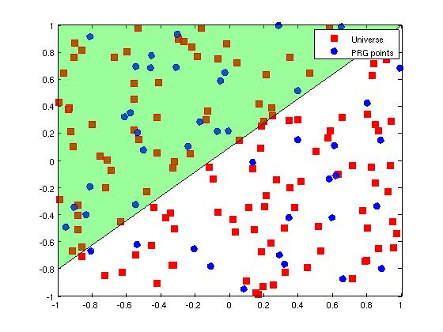
PRGs for PTFs
Small set preserving fraction of +’ve points for all PTFs
Fraction of Positive Universe points
~ Fraction of Positive PRG points
Small set of PRG Points
Universe of Points

Slide 6

PRGs for PTFs
Stretch r bits to n bits and fool degree d PTFs.

Slide 7
Previous Results
Our Results
Reference | Function Class | Seed Length
No nontrivial PRGs for degree > 1
Nis90, INW94 | Halfspaces with poly. weights
DGJSV09 | Halfspaces
Rabani, Shpilka 09 | Halfspaces, Hitting sets
KRS 09 | Spherical caps, Digons
This work | Degree d PTFs
This work | Halfspaces
Similar results for spherical caps

Slide 8
Independent Work
Diakonikolas, Kane and Nelson 09: -wise independence fools degree 2 PTFs.

Slide 9
Outline of Constructions
Essentially a simplification of the hitting set of Rabani and Shpilka.
1. PRGs for regular PTFs
Limited dependence and hashing
Berry-Esseen theorem and invariance principle
2. Reduce arbitrary PTFs to regular PTFs
Regularity lemmas and bounded independence
3. PRGs for logspace machines fool halfspaces
More general: fool monotone ROBPs
halfspaces.

Slide 10
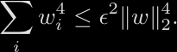
Regular Halfspaces
All variables have low “influence”.
Why regular? By CLT:
Nice target distributions:
Enough to find G such that

Slide 11
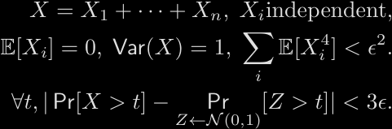
Berry-Esseen Theorem
Quantitative central limit theorem
Error depends only on first four moments! Crucial for our analysis.

Slide 12
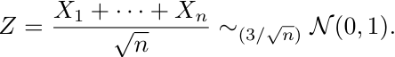
Toy Example: Majority
For simpliciy, let .
BET: For
Idea: Error in BET depends only on first four moments. Let’s exploit that!

Slide 13
Fooling Majority
Let Partition [n] into t blocks.
Observe:
Y’s are independent
Block 1
Block t
Conditions of BET:

Slide 14
Fooling Majority
Y’s are independent
Conditions of BET:
Y’s independent
First Four Moments
Blocks independent
Each block 4-wise independent
Proof still works:
Randomness used:

Slide 15
Fooling Regular Halfspaces
Problem for general regular: weights skewed in a block
Example:
Solution: partition into blocks at random
Analysis reduces to the case of majorities.
Enough to use pairwise-independent hash functions.
Some notation:
Hash family
4-wise independent generator

Slide 16
Main Generator Construction
x1
x2
x3
…
x1
x2
x3
x4
x5
…
xn
x2
x4
x5
…
xk
x4
x5
xk
…
xn
xn
xn
1
2
t
2
t
Randomness:

Slide 17
Analysis for Regular Halfspaces
x1
x2
x3
x4
x5
…
xk
…
xn
1
2
t
For fixed h, are independent.
For random h,
Analysis same as for majorities.

Slide 18
PRGs for Halfspaces
1. PRGs for Regular halfspaces
Limited dependence and Hashing
Berry-Esseen theorem
2. Reduce arbitrary halfspaces to regular case
Regularity lemmas and bounded independence
3. PRGs for logspace machines fool halfspaces
More general ‘monotone trick’
2. Reduction to regular case (Servedio, DGJSV):
Halfspace is regular – use previous analysis
Halfspace depends only on few variables – use bounded independence.

Slide 19
Outline of PRGs for PTFs
1. PRGs for regular PTFs
Limited independence and hashing
Invariance principle of Mossel et al. [MOO05]
2. Reduce arbitrary PTFs to regular PTFs
Regularity lemmas of Diakonikolas et al. [DTSW09], Harsha, Klivans, M. [HKM09]
Same generator with stronger .
Analysis more complicated:
Cannot use invariance principle as black box
New ‘blockwise’ hybrid argument

Slide 20
Read Once Branching Programs
Layered directed graph
vertices per layer
Edges between consecutive layers
Edges labeled
Input:
Output: Label of final vertex reached
T layers

Slide 21


PRGs for ROBPs
Stretch r bits to n bits and “fool” (S,D,T)-ROBPs.

Slide 22
Halfspaces computable by ROBPs
Can we use PRGs for ROBPs? No – ROBP can have large width
Our observation: Yes we can – ROBP is ‘monotone’
n layers

Slide 23
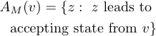
Monotone ROBPs
Ordering of vertices within layers such that transitions respect ordering

Slide 24
Halfspaces computable by Monotone ROBPs
Order vertices by partial sums
n layers

Slide 25

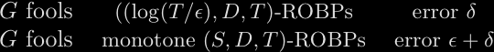
Fooling Monotone ROBPs
Monotone Trick: PRGs for small-width ROBPs fool arbitrary width monotone ROBPs.
Thm:
Cor: Nisan90, INW94 PRGs fool halfspaces with seed-length and error .
Already improves previous constructions.

Slide 26
Proof via Sandwiching
Pair of ROBPs -sandwiching for M if:
Bazzi 2006: Existence of small-width sandwiching programs enough.

Slide 27
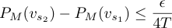
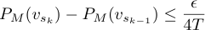
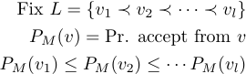
Sandwiching Programs - Sparsification

Slide 28
Sandwiching Programs – Edges
Sandwiching Programs – Proof
Sandwiching: every path is sandwiched
Approximating: error per layer is

Slide 29
Summary for Halfspaces
1. PRGs for Regular halfspaces
Limited independence, hashing
Berry-Esseen theorem
2. Reduce arbitrary case to regular case
Regularity lemmas, bounded independence
3. PRGs for ROBPs fool Halfspaces
More general ‘monotone trick’
PRG for Halfspaces

Slide 30
Subsequent Work
Reference | Result
Gopalan et al. [GOWZ09] | PRGs for functions of halfspaces under product distributions
Harsha et al. [HKM09b] (new IP + generator) | Quasi-polynomial time approx. counting for “regular” integer programs
Gopalan et al. [GKM10] | Deterministic approximate counting for knapsack

Slide 31
Take Home …
PRGs from invariance principles
IPs give us nice target distributions to aim.
Error depends on first few moments – manage with limited independence + hashing.
Monotone trick
Width not important if more structure in ROBP.
PRGs of Nisan90, INW94 always more powerful than we know them to be.

Slide 32
Open Problems
Better PRGs for PTFs?
Optimal non-explicit:
Possible approach: adapt monotone trick to work for higher degree PTFs.

Slide 33
Open Problems
Optimal PRGs for Monotone ROBPs?
Improving Nisan90, INW94 an outstanding open problem.
Monotone ROBPs an important special case.

Slide 34
Open Problems
More applications of ‘PRGs from invariance principles’?

Slide 35
Thank You

